Slide 1

재미한인과학기술자협회
Korean-American Scientists and Engineers Association
(KSEA)
2026. 9

Slide 2

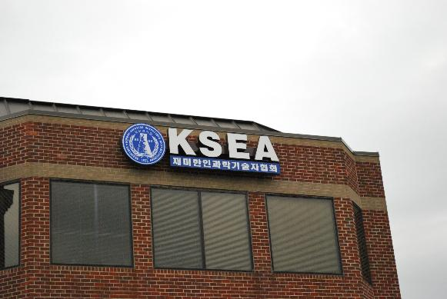
KSEA: At Glance
501(c)(3) non-profit organization
1952 Gallows Rd, Suite 300, Vienna, VA
Established on December 11, 1971 in Washington DC
Contributed tremendously for the US-ROK collaboration in science and technologies last 55 years
KSEA by Numbers
  8,000+ paid members
  70+ chapters/branches across the US
  31 student/campus chapters
  16 technical groups for all science and engineering
  37 affiliated professional Societies

Slide 3
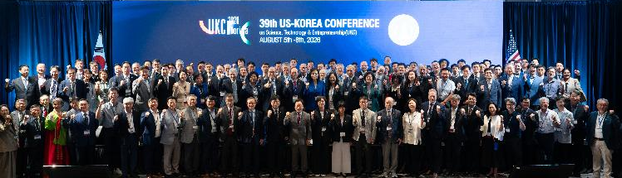

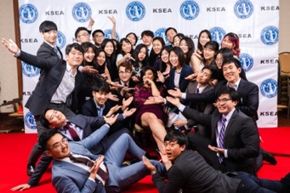
KSEA: Vision
Excel as a leading Korean-American scientific, engineering, and industrial organization
Contribute to the social welfare and industrial development in the U.S. and Korea by promoting science and engineering

Slide 4
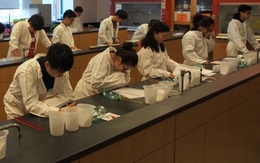
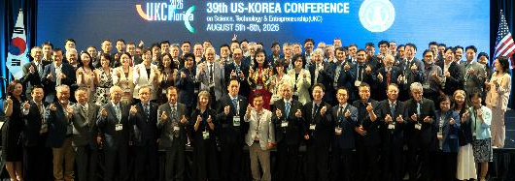
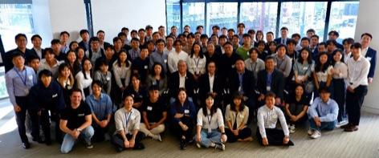
KSEA: Missions
Promote science, technology, and entrepreneurship for the general welfare of society
Enhance the networking and collaboration among Korean-American professionals engaged in science, engineering, and related fields
Foster international cooperation especially between the United States and Korea
Cultivate Korean-American scientists and engineers to reach their full career potential
Serve the Korean-American community

Slide 5
KSEA: Members
30,000 login and 8,000 active members
Highly educated and trained

Slide 6
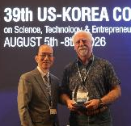
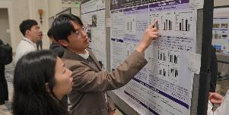
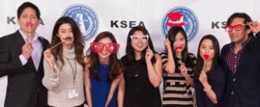
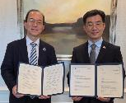
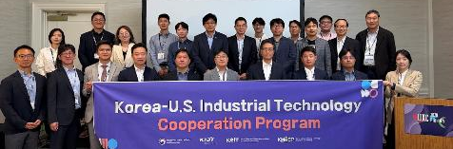
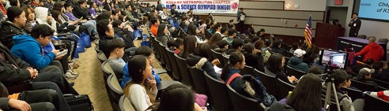
For The Members
Professional and leadership development
Scientific/technical education and training
Networking at global, national and local events
Professional opportunities in the U.S. and ROK
Awards, scholarships and start-up investments
Research grants and collaborative links
Seniors and next-generation

Slide 7
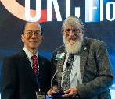
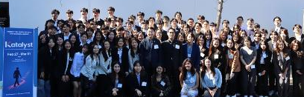
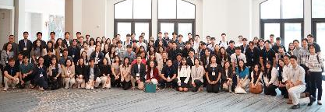
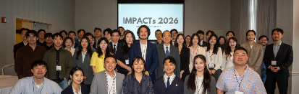
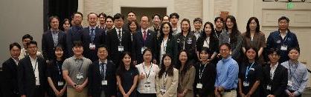
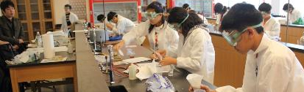
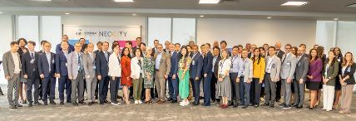
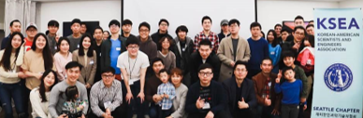
Conferences, Workshops, Programs
US-Korea Conference (UKC) on Science, Technology and Entrepreneurship
Scientists and Engineers Early Career Development Workshop (SEED)
Young Generation Technology & Leadership Conferences : “IMPACTs” for young professionals and “KATALYST” for undergraduate students
National Mathematics, Physics and Science Competition (NMSC)
Entrepreneurship Training, Competition and Investment
(IES)
Over 150 regional/local and thematic/topical programs annually

Slide 8
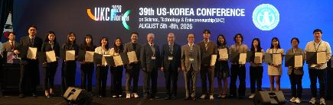
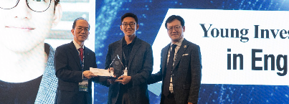
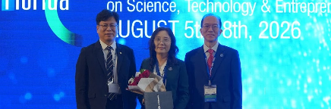

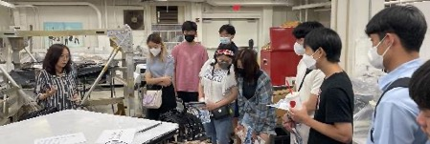
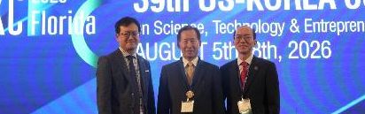

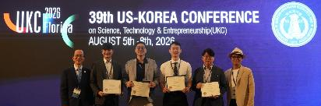

Awards, Grants, Scholarships and Publications
KSEA Awards
Scientist, Engineers and Entrepreneur of the Year
KSEA Young Investigator Grant
Recognize those who have demonstrated the outstanding early career as a young investigator in science or technology
(2) $10,000 grants
KSEA Student Scholarships
$1500 for 20 undergraduates and
$2000 for 20 graduates
KSEA Post-Doctoral Fellowship
$2500 for 5 Post-Doctoral scholars
Technical Reports, Conference Proceedings, Quarterly Journal

Slide 9
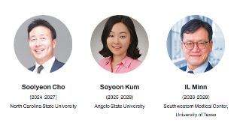
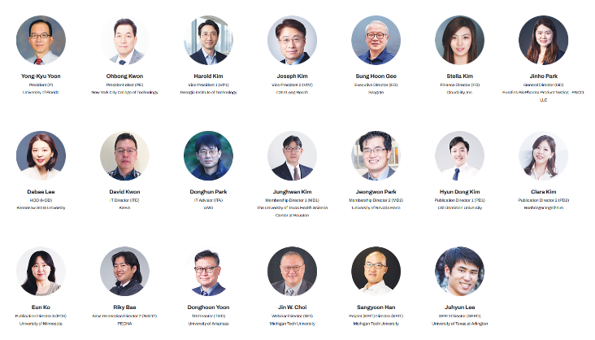
KSEA: Governance and Operation
(Volunteer) 55th Executive and Directors Committee
(Volunteer) Auditors
13 Standing Committees with Volunteer Members:
Contest, Election, Fund Management, History, Honors and Awards, Long Range Planning, Nomination, Rules, Scholarships and Fellowships, Young Generation, Affiliated Professional Society, SME, UKC Steering Committees
Headquarter Staff
Director of Administration
Finance Manager
IT Staff
Admin Associate Staff

Slide 10
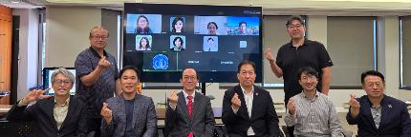
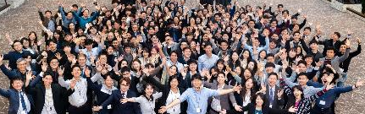
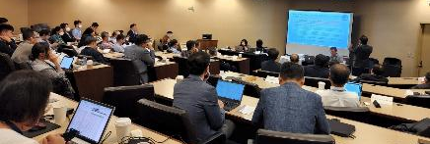
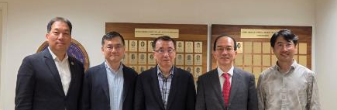
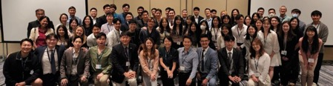
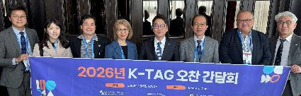
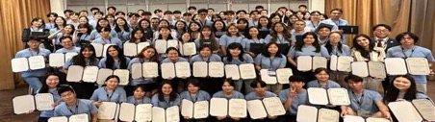

Korean American Scientists
and Engineers Association (KSEA)
Visit Us at
www.ksea.org
Follow Us on LinkedIn
Follow US on YouTube
Follow Us on Facebook

Slide 11
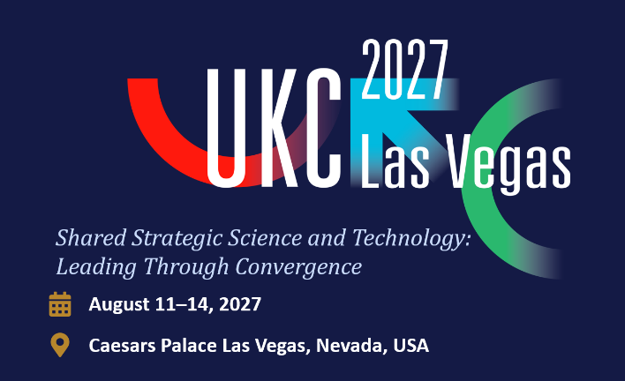

See you at UKC 2027 in Las Vegas !

